Slide 1
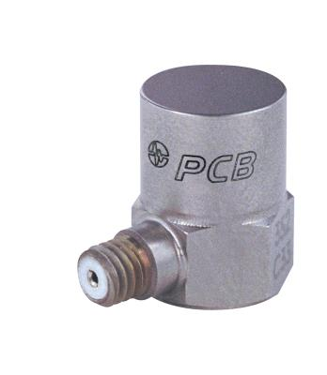
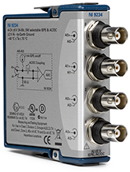
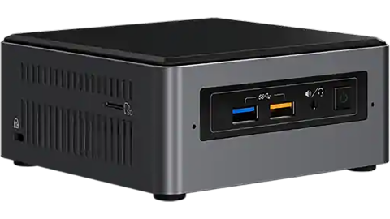
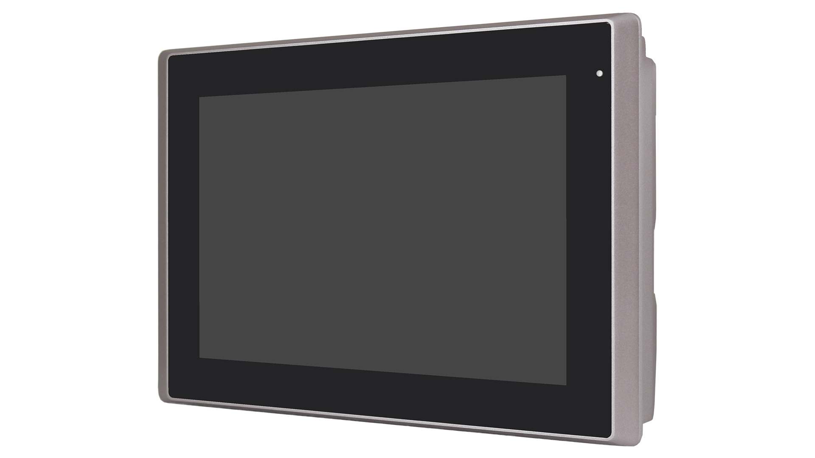

Hardware
Sensor
DAQ
PC
Monitor

Slide 2

Hardware
Sensor
DAQ
PC : Local data processing / HMI
Monitor
internet
PC

Slide 3
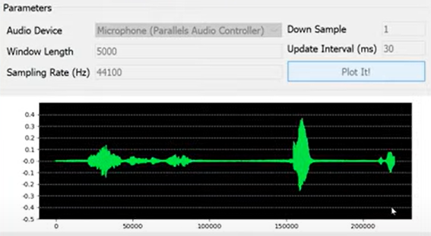
Software environment
OS | Programming Language | Packages | 用途
Windows / Linux (future) | Python | numpy | array and math function
 |  | scipy | math function
 |  | matplotlib | mathematical visualization
 |  | pandas | Dataframe processing
 |  | nidaqmx | 控制 NI DAQ
 |  | pyqt6 | GUI framework
 |  | pymongo | Control Mongo Database

